Slide 1

Serverless Azure In The Enterprise Adam Stephensen & Duncan Hunter
Notes:
Adam: Welcome to our talk Serverless Azure in the Enterprise.
---------------------- INFO ------------------
NDC Title: Serverless Azure In The Enterprise
Description: Serverless is not just for start ups. Australia's largest finance and government agencies are using these patterns in production to push the boundaries of scalability and resiliency. In this session we will look at modern Azure architectures for shipping apps and API's based on work we have done with organisations around Australia. Join us as we look at how you should architect your next app in Azure.

Slide 2

Serverless is great!
Infinite scale
Per second billing
Simple HA and DR
Logic app connectors
Amazing productivity
Notes:
Adam: Let’s see if this resonates with anyone.
You’ve learnt about serverless and you have done some proof of concepts.
You get a new project, and it feels like a great fit. You’re super excited. You book a meeting with the architecture team, IT and security…
(click) You explain how great serverless is – it scales infinitely, it has per second billing and no resting cost, high availability and disaster recovery are simple, logic apps are going to remove the need for writing integrations, and you’ll be so much more productive.

Slide 3
All this stuff has public endpoints ?
How am I going to monitor and secure it ?
I’m already too busy without learning new things
Because we have a short timeframe let’s just do it the old way.
Notes:
Adam: As your doing your explanation through – you realise your are getting blank stares.
The reason that this conversation doesn’t go so well is that often the person on the other side of the table has different priorities to you as a developer.
Their priority may be uptime, or security or ongoing maintenance.
They may be thinking something like...
(click) ‘If all this stuff is internet facing and anyone can hit the endpoint, I’m not OK with that risk.
(click) How am I going to monitor and secure this thing – it sounds like lots of small pieces. That’ll be a lot of work’
(click) Or commonly they are concerned that their business as usual work already has them at capacity and this sounds like a lot of new things to learn.
We hear about this all the time. What these meetings ends with is a plan that (click) ‘because have a short timeframe let’s just do it the old way’.

Slide 4
We’ll write serverless, event-driven code, but there are is a spectrum of deployment options.
PCI / IRAP Protected, serverless compute or somewhere in the middle. Can we get together to find the right balance of control, scale and cost for this project?
Notes:
Adam: Contrast this with a dev who comes into the meeting and says
(click) This workload is really event driven and so we are going to use a serverless programming model.
(click) Depending on the project needs we can deploy this into a highly controlled environment… even something that is PCI or IRAP Protected certified, or we can leverage super-scalable, really cheap serverless compute … or we can choose an option in the middle.
Can we get together to find the right balance of control, scale and costs for this project ?

Slide 5

I can secure it up to PCI / IRAP protected ?
I can use network controls without needing to maintain servers ?
That sounds great. Let’s get the team together.
Notes:
Adam: Reframing the conversation this way is much more likely to lead to a positive outcome.
If you want to get traction with serverless in your organisation,
the key is to ensure that the other teams you are working with understand
that the serverless paradigm doesn’t mean that they can’t also meet their goals.

Slide 6


Adam Stephensen
Duncan Hunter
Notes:
Adam: Hi, I’m Adam Stephensen – I work for Microsoft as an Azure Specialist. My job is to work with the state governments, financial instutions and large commercial customers, and help them architect and deploy workloads into Azure.
Duncan: I’m Duncan Hunter and I also work for Microsoft as an Azure Specialist here in Sydney and I work with our largest financial services industry and federal government customers. But I have not just got experience with Azure serverless offerings but also have got a bunch of commercial experience shipping and maintaining Serverless apps on Google Cloud Platform with Firebase.

Slide 7
Serverless in the enterprise is main stream
Notes:
Adam: Duncan and I are here doing this talk, because we are working with enterprise public sector and commercial customers every day doing serverless.
A few years ago… serverless was being talked about, and had traction in smaller companies but didn’t have widespread adoption in enterprise.
That’s all changed now… nearly every customer I work with is leveraging serverless – in government, in banks and in commercial.
That’s why we are here today – we want to help you add value to your organisation by sharing our experience with serverless in the enterprise.

Slide 8
What is Serverless (to us!)
Event driven - auto-scale
No infrastructure management
Only pay for what you use
Notes:
Adam: Serverless is such a broad topic, and there are lots of different interpretations. Duncan and I work on the same team on and the same technologies. But when we started to work on this talk together we had several conversations coming together on what our definition of serverless is. What we have agreed upon – for the moment at least – is that serverless really has three aspects –
(click) the first relates to an event driven programming model,
(click) the second relates to a hosting abstraction where the developer need not worry about the underlying compute that their code is executing upon
(click) and the third is that you only pay for what you use.
Duncan: But the part we discussed the most is pricing, I feel that that for something to be a serverless you should only pay for the amount of compute or time a service is actually running. To me a classic Azure PaaS service like an Azure App Service, to run a normal API or web app on, is not serverless because it is billed hourly and can not be turned off or ‘scaled to zero’. So yes you do not have to manage the servers but you do have to pay for it constantly regardless of if it is not doing anything.
So I have some colleagues who just call most of the Azure PaaS services serverless and I always cringe but it feels like the community definition of serverless is shifting. So for example work has already begun on adding a ‘scale to zero’ tier to the Azure App Service Plans inspired by other serverless services now with scale to zero plans like SQL DB, Cosmos DB and of course functions.
I am guessing the trend to just call everything PaaS serverless will continue but what is interesting is we are seeing more and more PaaS services have a scale to zero or serverless option.
Adam: (offer opinion to balance the discussion and make us look like experts not just implementers of some tech or azure sales people)
My challenge is this. An azure function on serverless compute is definitely serverless. Is an Azure function on a hosted Kubernetes cluster serverless ?
If the developer works in an event driven manner, and doesn’t have to worry about the underlying infrastructure… isn’t it serverless ?

Slide 9
How you should build your next app
Agenda
Why isn’t everyone doing this today?
What are people doing now?
Notes:
Adam:
Before we talk about what we are going to cover I just want to call out that this isn’t a 101 serverless talk. We aren’t going to cover all the benefits of serverless and how to get started… there are many, many, many talks covering those topics. We want to share what are seeing in the enterprise, the techniques and patterns we are seeing that are being successful and emerging trends.
Duncan: We are going to start off with a look at how we would build a serverless application today. We’ll check out the architecture and all the components and share the open source project we are collaborating on to make starting a project like this the right way a couple of minutes versus a couple of days.
Adam: (click) then we will look at the reasons why a lot of our customers just can’t deploy that purely serverless, multi-tenant application, and the patterns and architectures that compromise between the pure promise of serverless, and the real work requirements of the enterprise. We’ll look at
patterns and architectures that can keep CSOs and IT admins happy with security requirements all the way up to protected,
we will have a look at how to leverage serverless and still have a multi-cloud strategy,
how to leverage the benefits of containers and Kubernetes and serverless at the same time,
Duncan: (click) And finally we will have a look at a few real life implementations we have done with our government and commercial customers.

Slide 10
How you should build your next app
Agenda
Why isn’t everyone doing this today?
What are people doing now?
Notes:
Duncan:
Lets have a look at how we would build the perfect reference serverless application today.
Now we are going to use this architecture as our starting point but this is not what we see in the enterprise so in the following sections we will talk about why everyone isn’t building serverless applications this way in the enterprise and then demonstrate similar architectures implemented with multiple levels of security.

Slide 11

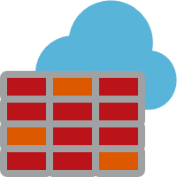
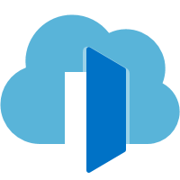


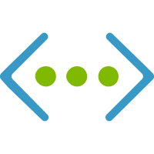
Azure Front Door
Notes:
Duncan:
The entry point to your serverless APIs or any of you applications should be Azure Front Door. Azure Front Door gives you a global, scalable entry-point that uses the Microsoft global edge network to create fast, secure, and scalable apps.
It wraps up three features to achieve this:
First a WAF or web access firewall.
Second is a load balancer to route traffic between azure regions similar to the Azure Traffic Manager which we feel Azure Front Door replaces for many people.
And lastly it acts as a CDN, caching your static assets on the edge for faster content delivery.

Slide 12

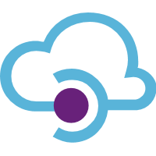
Multi-tenant Services
API Management
APIs
Function App
Gateway
Function App
(public preview)
Azure Front Door
Azure Region #1
Notes:
Duncan:
The other nice part of Azure Front Door is once you hit an Azure point of presence your request will travel over Azures back bone versus the public internet to the appropriate regional data center making it even faster.
Any requests to your API’s would go via an instance of Azure API Management run in a serverless based pricing tier. API Management is your gateway into your API’s to help accelerate API development for exposing both internal and external APIs. Of course you can expose your APIs individually but to avoid the chaos of many separate parts, different teams processes, security and sharing of APIs then API Management definitely a best practice for your serverless workloads.
(click) For your APIs you would leverage Azure Function Apps on a serverless consumption tier and (click) hot off the press now in public preview you can now run Azure logic apps on the functions run time in a function app or container. Logic apps for those who haven’t seen them are a serverless workflow solution and are event driven like functions except rather than write code you drag and drop logic in a GUI.

Slide 13
using System.Net;
using Microsoft.AspNetCore.Mvc;
using Microsoft.Extensions.Primitives;
public static async Task<IActionResult> Run (HttpRequest req) {
string name = req.Query["name"];
string responseMessage = string.IsNullOrEmpty (name) ?
"HTTP triggered function executed." :
$"Hello, {name}. HTTP triggered function executed.";
return new OkObjectResult (responseMessage);
}
Notes:
Duncan:
This is what a http triggered Azure function looks like in C# but they come in many languages. You do not need to read this code it is just to show they are generally small event driven blocks of code like this that do one thing and can be scaled on demand and then scaled to zero or maybe one instance to keep them warm.

Slide 14
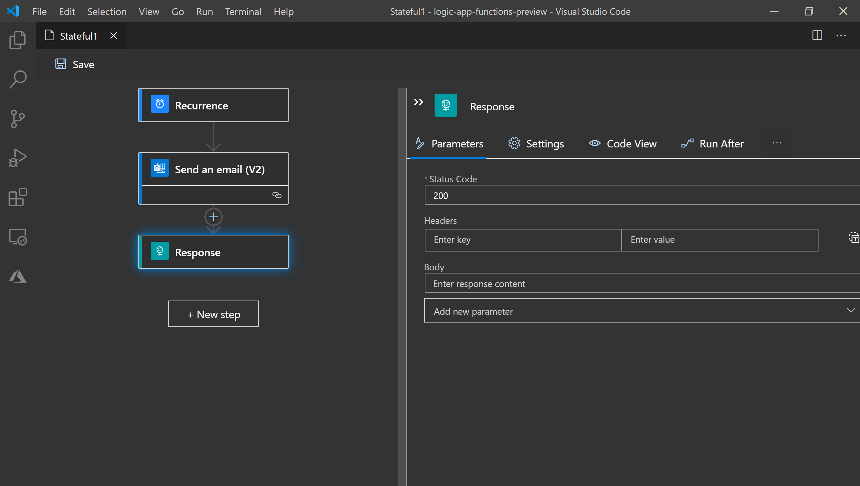
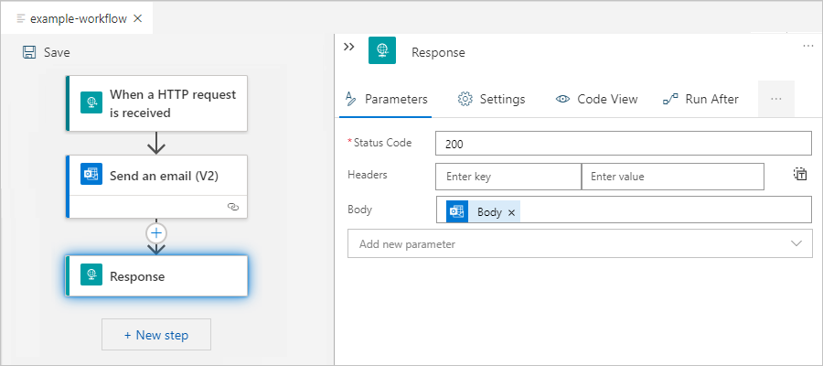
Notes:
Duncan:
This is what a logic app looks like with the new upgraded designer that can work offline in vscode. As I mentioned they are like functions but you design them in a GUI and more suited for workflows that connect multiple services.

Slide 15

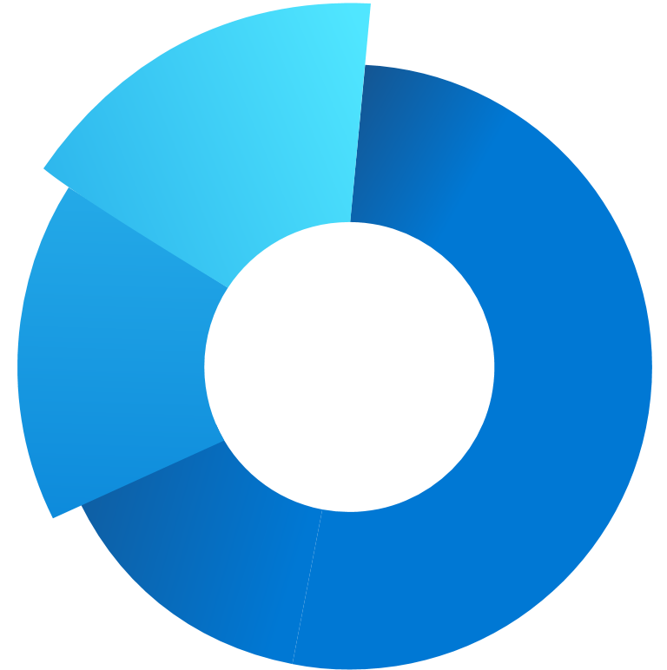
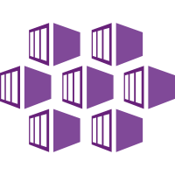
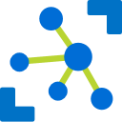
Ways to Run Functions
Consumption
Serverless
App Service Plan
Free, Basic, Standard & Premium
App Service Environment
Network Isolation
Azure Stack
On Premise
Azure Function
Run Time
Functions on
Your Servers
Azure IoT Edge
On Devices
Notes:
Duncan:
There are heaps of ways you can run Azure functions
(click) Such as in a pure serverless consumption plan
(click) On an App Service Plan where you would normally host a web app in a PaaS style
(click) An App Service Environment which is like an app service plan but with dedicated resources and complete network isolation
(click) On Premise with Azure stack hardware
(click) With Kubernetes on your servers in any cloud or on premise
(click) On physical devices with Azure IoT Edge
We joke that serverless does not mean there are no servers but just you do not have to manage them, but as you can see from this list this is changing and you can also run functions on the servers you do manage.
I think we are seeing this desire to host your own functions to leverage the power of its event driven programming model to make simpler apps that scale and encourage making micro services over monoliths. It is just one more reason why it is getting harder to describe what is serverless.

Slide 16
Ways to Run Functions & Logic Apps
Consumption
Serverless
App Service Plan
Free, Basic, Standard & Premium
App Service Environment
Network Isolation
Azure Stack
On Premise
Azure Function
Run Time
Functions on
Your Servers
Azure IoT Edge
On Devices
Notes:
Duncan:
As we mentioned already, Logic apps running on the function run time is in public preview, so all these places you can run a function you can soon run a logic app which is pretty cool.

Slide 17

Multi-tenant Services
API Management
APIs
Data Services
Function App
Azure Storage
Gateway
Function App
(public preview)
Cosmos Db
Azure Front Door
Azure Region #1
Notes:
Duncan:
Backing these serverless functions and logic apps we can use a combination of Azure Blob storage and Azure Cosmos DB. Cosmos DB is a globally distributed no SQL horizontally scalable database. That basically means it is a modern and fast multi region database!
And currently has a serverless pricing tier in public preview for the SQL query API and soon the other query API’s like MongoDB. This combination of Azue Blob Storage for static assets and Cosmos DB for querying more complex data will cover most of your data and storage needs.

Slide 18



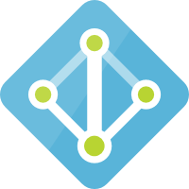
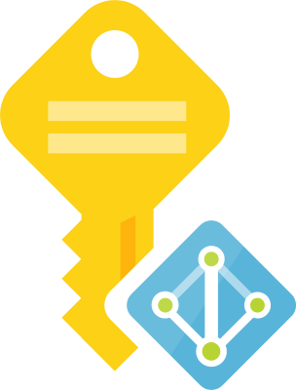
Multi-tenant Services
API Management
APIs
Data Services
Function App
Azure Storage
Gateway
Function App
(public preview)
Cosmos Db
Azure Front Door
Azure Region #1
Geo-replicate
Multi-tenant Services
API Management
APIs
Data Services
Azure Monitor
Function App
Azure Storage
Key Vault
Gateway
Function App
(public preview)
GitHub – Repo & Actions
Cosmos Db
Azure AD &
Managed Identities
Azure Region #2
Notes:
Duncan:
Cosmos DB being designed to be globally distributed makes it easy to geo replicate you data across regions.
(click) API Management, functions and logic apps also all have a consumption based tier making them not only an ideal choices for an event driven serverless set up like this. It make deploying to multiple regions easier when you are only paying for what you use as it doesn’t matter how many regions you have it deployed into. So it is trivial to run in an active/active model to achieve high availability and fast disaster recovery. It also allows the same ease and cost savings deploying across all your environments spanning from dev to preprod to prod and for blue green deployments to gradually roll out changes to your API’s.
(click) Of course for good measure we would throw in Azure Monitor on the bottom left here to have good observability across our digital estate.
(click) Key Vault for securely storing all or keys and certificates.
(click) Github for our repos, ci/cd pipelines and automation.
(click) and Azure Active directory not only for managing user authentication and user access to your APIs but also for development to authenticate between services in your backend with managed identities so you do not have to manage secret and certificate rotations.

Slide 19
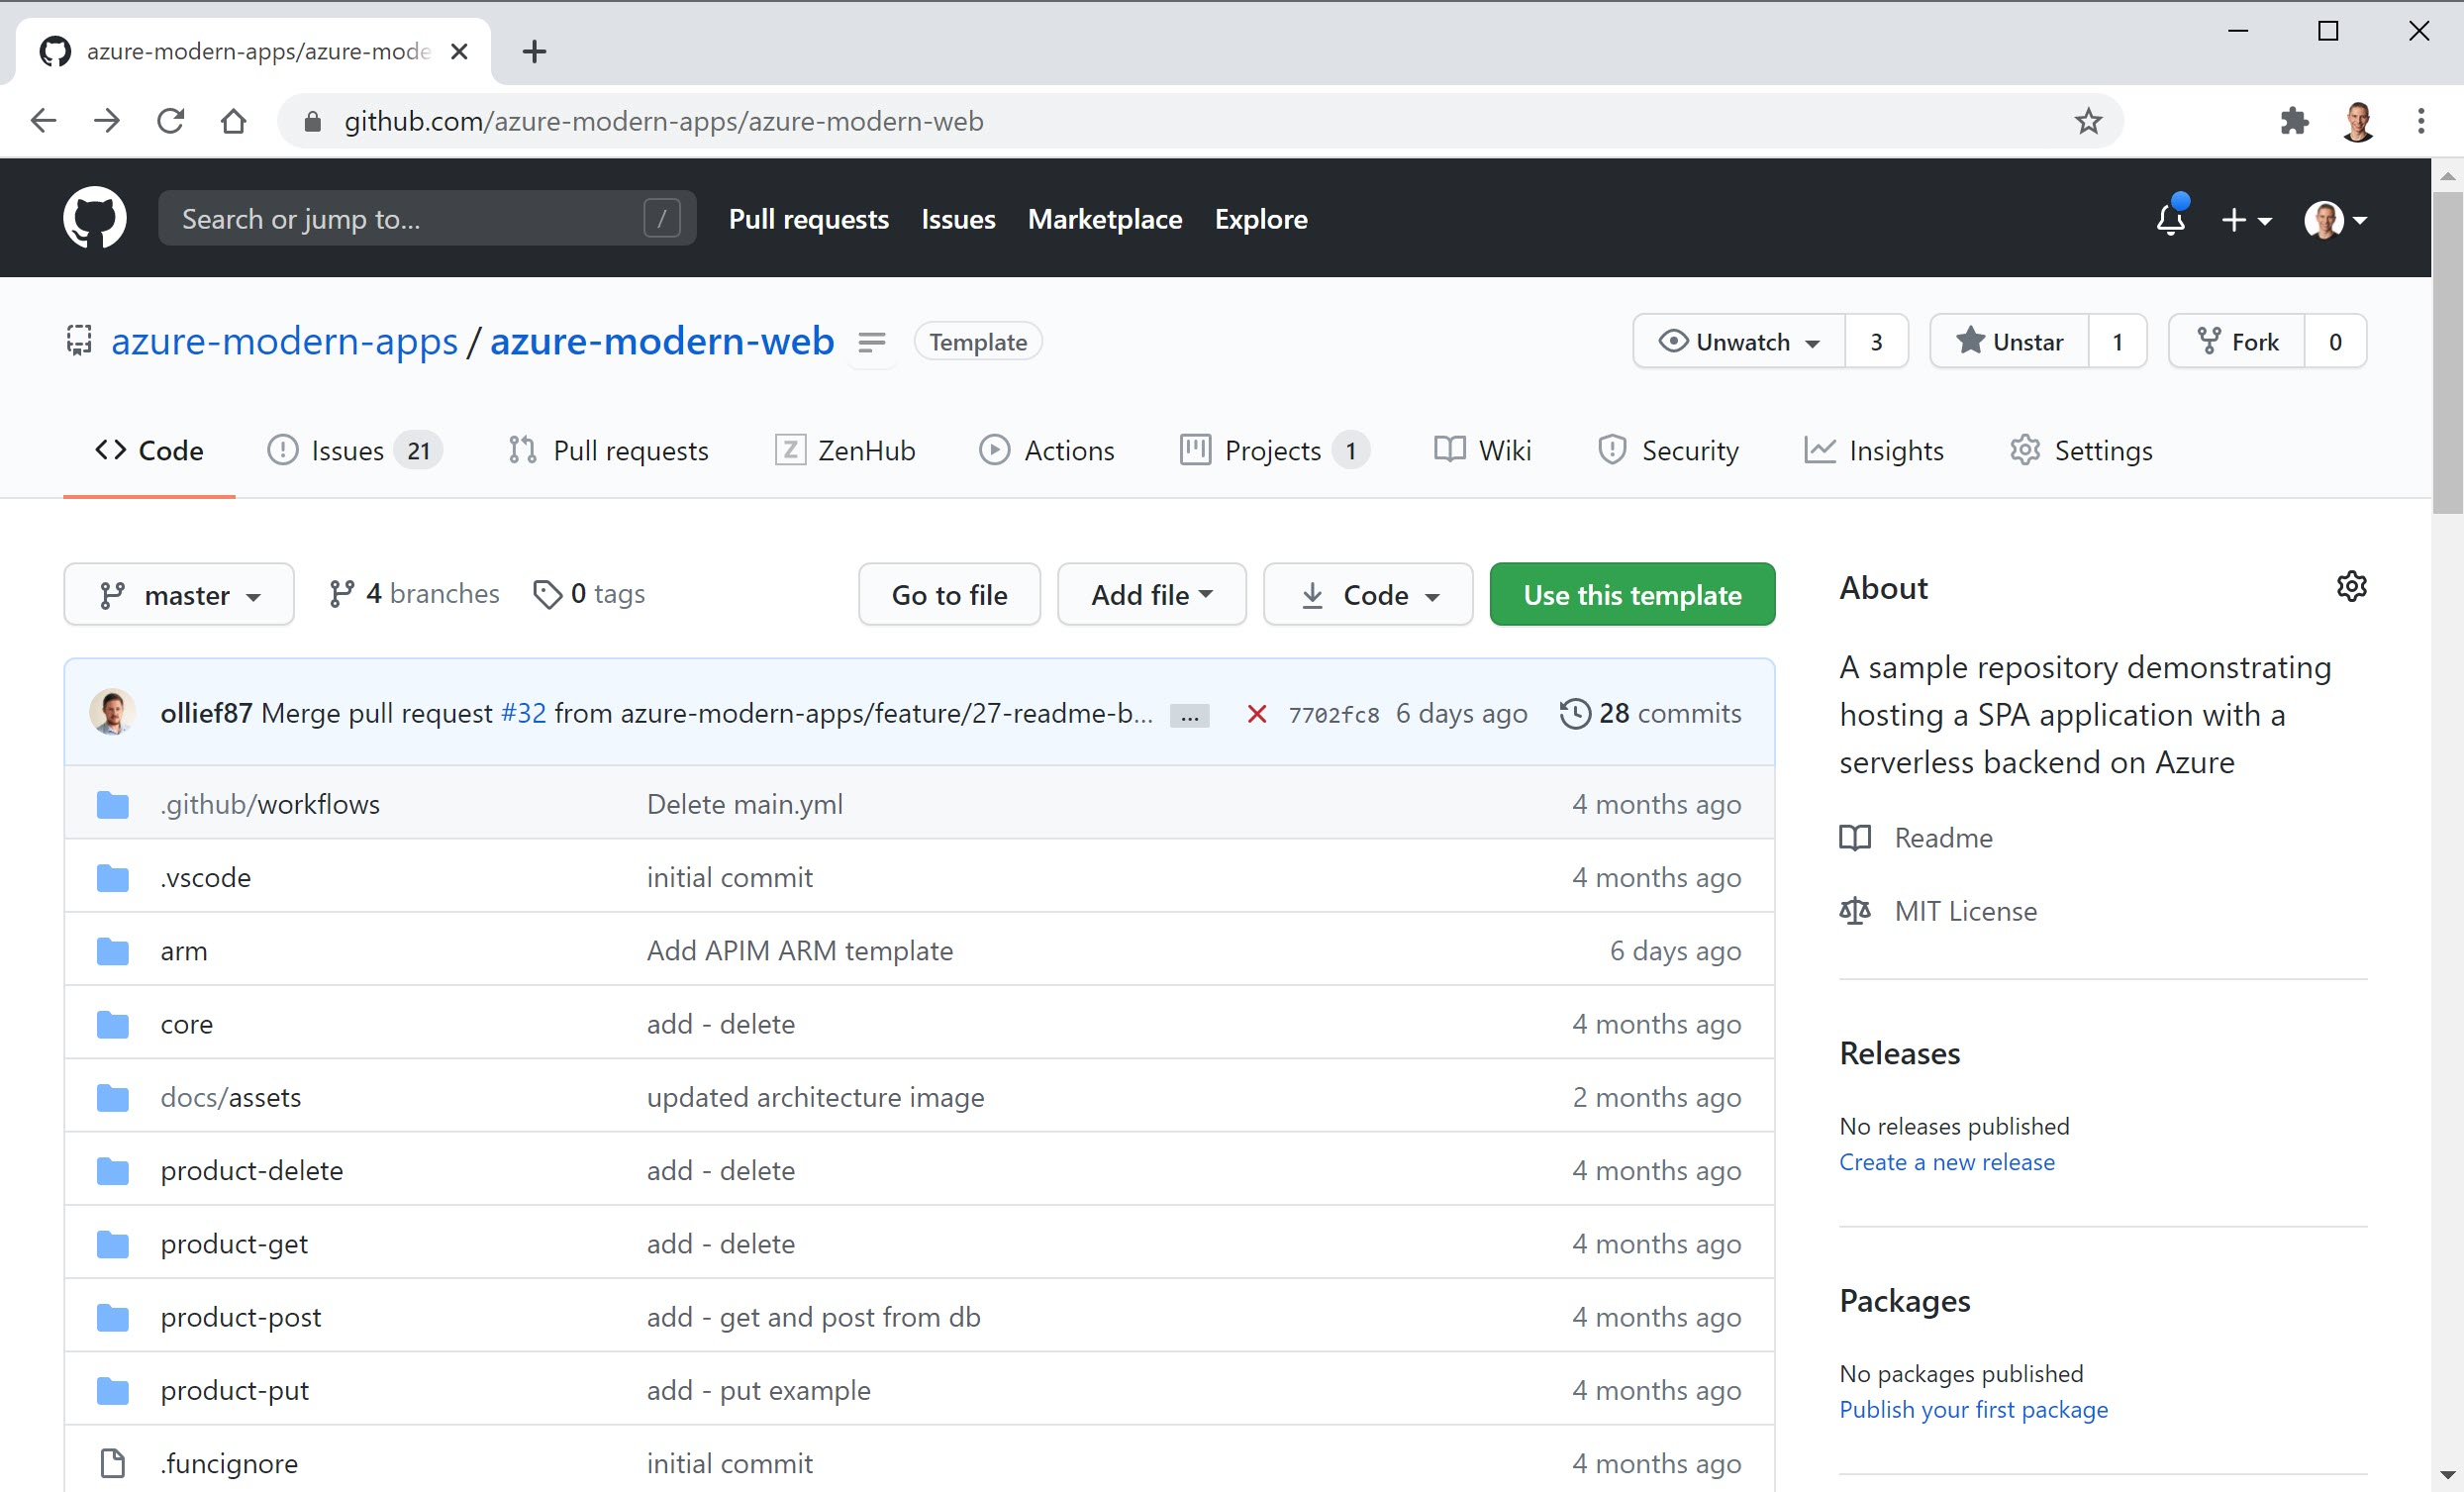
Github picture (placeholder slide)
Notes:
Duncan:
I am going to do a small shameless plug here. We are currently building this architecture as an open source serverless starter with some of our partners like Insight her in Sydney and Brisbane. So if you are interested please join us in building this starter and feel free to reach out and connect to us via this repo.

Slide 20
Multi-tenant Services
API Management
APIs
Data Services
Function App
Azure Storage
Gateway
Function App
(public preview)
Cosmos Db
Azure Front Door
Azure Region #1
Geo-replicate
Multi-tenant Services
API Management
APIs
Data Services
Azure Monitor
Function App
Azure Storage
Key Vault
Gateway
Function App
(public preview)
GitHub – Repo & Actions
Cosmos Db
Azure AD &
Managed Identities
Azure Region #2
Notes:
Duncan:
So this is super awesome and best practice but there is one main thing here that is missing, which we see almost all our enterprise customers require rightly or wrongly. So I will hand you over to Adam to discuss what that is.

Slide 21
How you should build your next app
Agenda
Why isn’t everyone doing this today?
What are people doing now?
Notes:
So what is the big challenge to doing serverless in the enterprise ?

Slide 22

Serverless #1 Technical Challenge: Control
Notes:
It is control.
A perceived lack of Control is the #1 technical challenge that stops customers implementing paas and serverless in the Enterprise

Slide 23
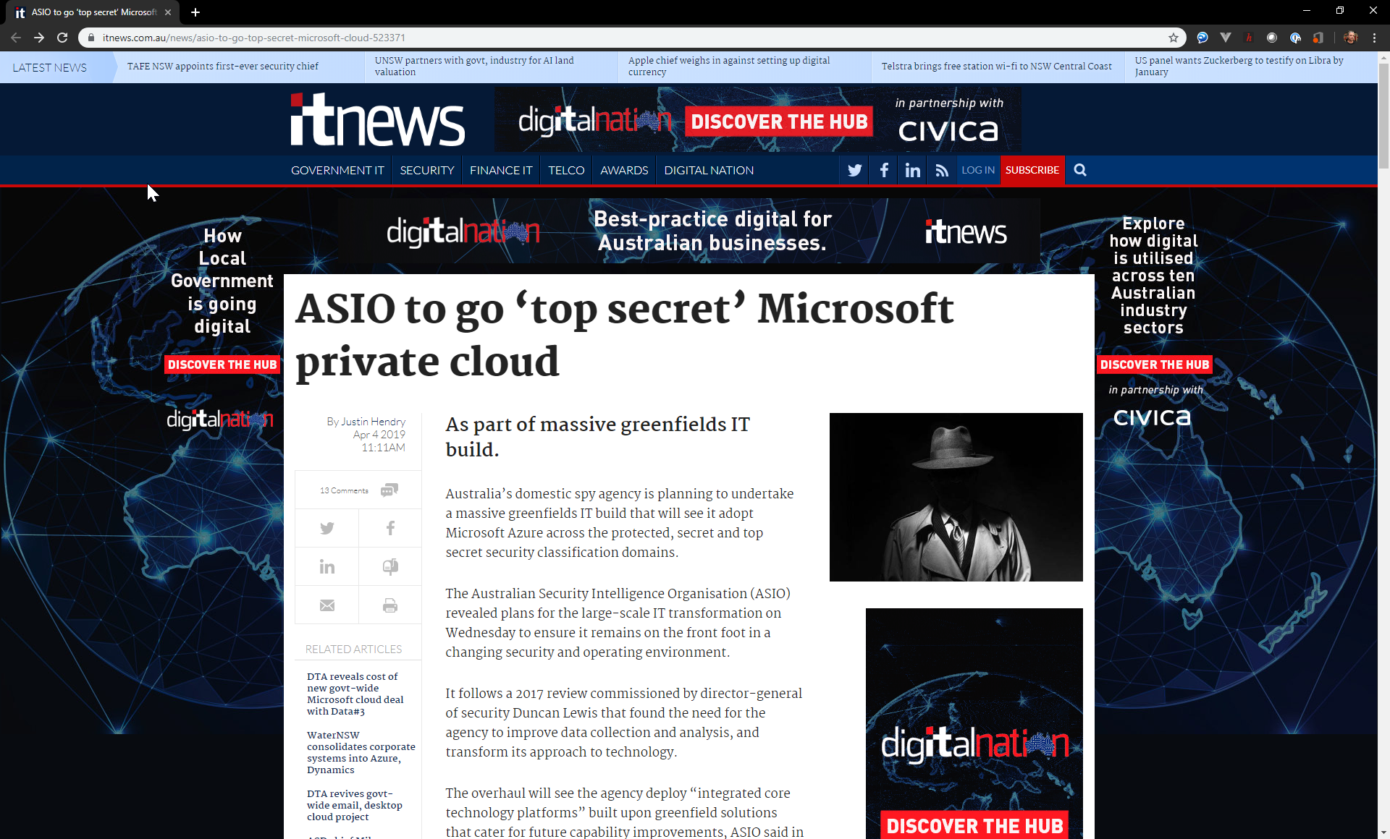
Notes:
It’s not too hard a conversation to start having with your organisation though….
In australia, ASIO uses Azure for secret workloads

Slide 24
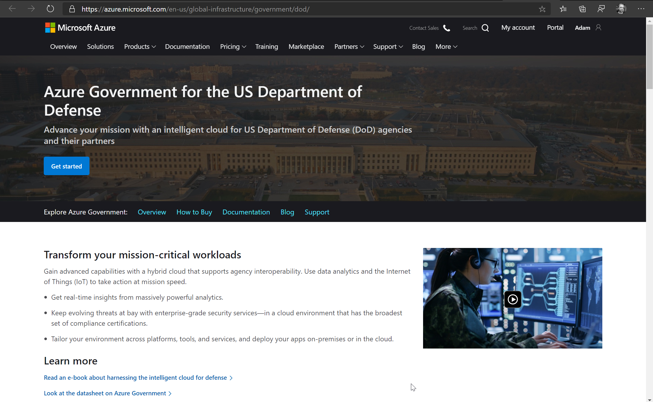
Notes:
The US Department of Defence is putting billions of dollars into their Azure platform

Slide 25
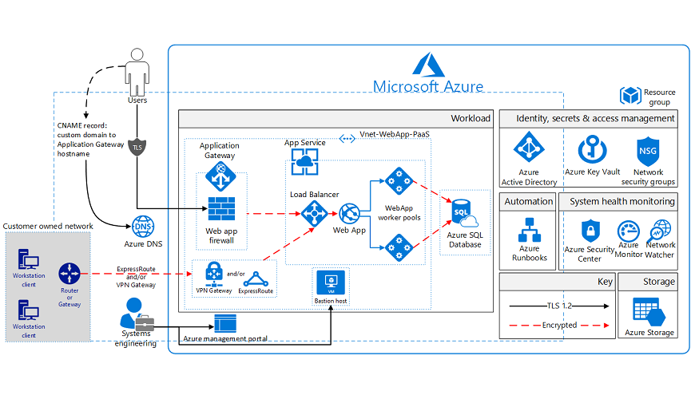
#1 Challenge: Control
PaaS Web Application for Australia PROTECTED
https://docs.microsoft.com/en-us/previous-versions/azure/security/blueprints/au-protected-paaswa-overview
Notes:
We have docs on how to build web applications up to an Australian Signals Directorate IRAP Protected approved architecture.

Slide 26
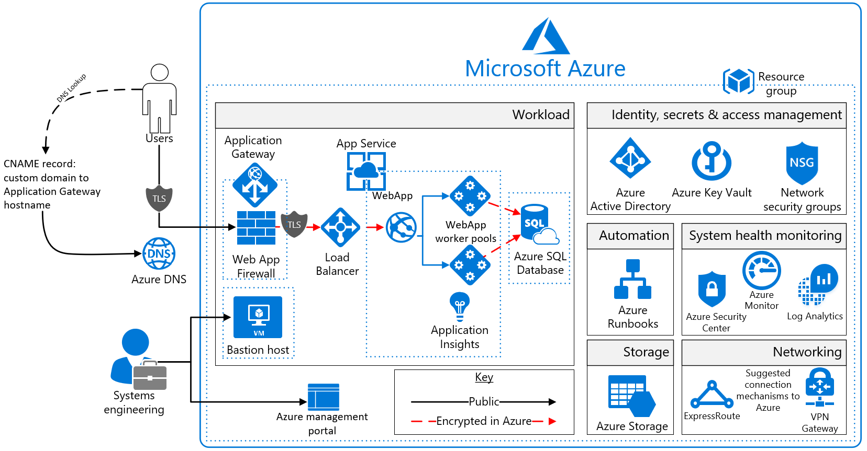
#1 Challenge: Control
PaaS Web Application for PCI DSS
https://docs.microsoft.com/en-us/previous-versions/azure/security/blueprints/pcidss-paaswa-overview
Notes:
We also have an architecture for financial services companies like banks that is PCI DSS certified.
Banks, Federal and State government and security organisations are trusting sensitive workloads to PaaS.
In organisation that have trust issues…. I find starting from a place of safety is best.
That’s why I love these reviewed and approved architectures.
They let us have the conversation about the sensitivity of the application we are building….
A good question to explore with your company is sometimes: ‘if banks and government departments can host sensitive workloads on PaaS – why can’t we ?’.

Slide 27
We’ll write serverless, event-driven code, but there are is a spectrum of deployment options.
PCI / IRAP Protected, serverless compute or somewhere in the middle. Can we get together to find the right balance of control, scale and cost for this project?
Notes:
And as I tried to portray at the beginning.
…. The issue is often how the developers introduce new patterns and technologies to an organisation often determine their success…

Slide 28
Developers: If you want serverless – you need to advocate the serverless security spectrum and networking patterns.
Notes:
Developers: If you want use serverless – you need to advocate the serverless security spectrum and networking patterns inside your organisation.
The architects and the security team want to see
How do we apply network controls,
how do we do monitoring and logging,
what uptime am I going to get and how much is it going to cost.

Slide 29
Serverless Web App Compute Spectrum
Serverless on Isolated Compute
Multi-tenant Serverless with Network Isolation
Multi-tenant Serverless
Control
Full network isolation.
e.g. IRAP, PCI
Network isolation via Private Link + VNet integration
Identity based security
Compute
Isolated PaaS
Premium Functions
Regular Functions
Private networking, no cold start, better scaling
Benefits
Control
Flexibility,
infinite scale,
cheaper
Notes:
I explain the serverless compute spectrum like this
We can take our serverless functions and deploy them on isolated compute… just like the PCI and IRAP Protected blueprints.
What happens in the Isolated tier is that the VMs running under the covers both for hosting the web applications and the control planes are dedicated to you, and are run in your own private address space.. You get all the control of full network isolation. Of course…. You are also paying for a lot of reserved compute.
(click)
On the other end of the spectrum is the serverless compute model. Most presentations and demos on serverless are focussing on this. You are running functions on the consumption plan, only paying for what you use, not having any resting cost, scaling almost infinitely and deploying with agility and flexibility.
… but getting pushback because every azure function and logic app has a public url and ip address… which even though it is secured using authentication and authorisation… raises the hair on the backs of security professinoals.
(click)
Where I want to spend time with you, is helping you with the technologies that land you here in the middle ground – and give you the best of both worlds. If we use Premium Azure Functions we get a few great benefits – we avoid the cold start issue of serverless, we more proactive scaling, and we get additional networking capabilities.
Those networking capabilities allow us to rlocks down all access via the web or public ip addresses to our services.
This is the sweet spot that we are working with many customers towards. It meets the requirements of the IT Pro and security teams, and still gives the developers all the benefits of serverless that they are chasing.

Slide 30
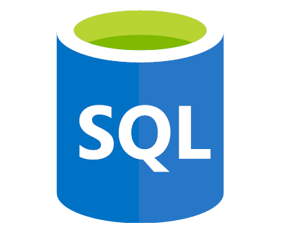
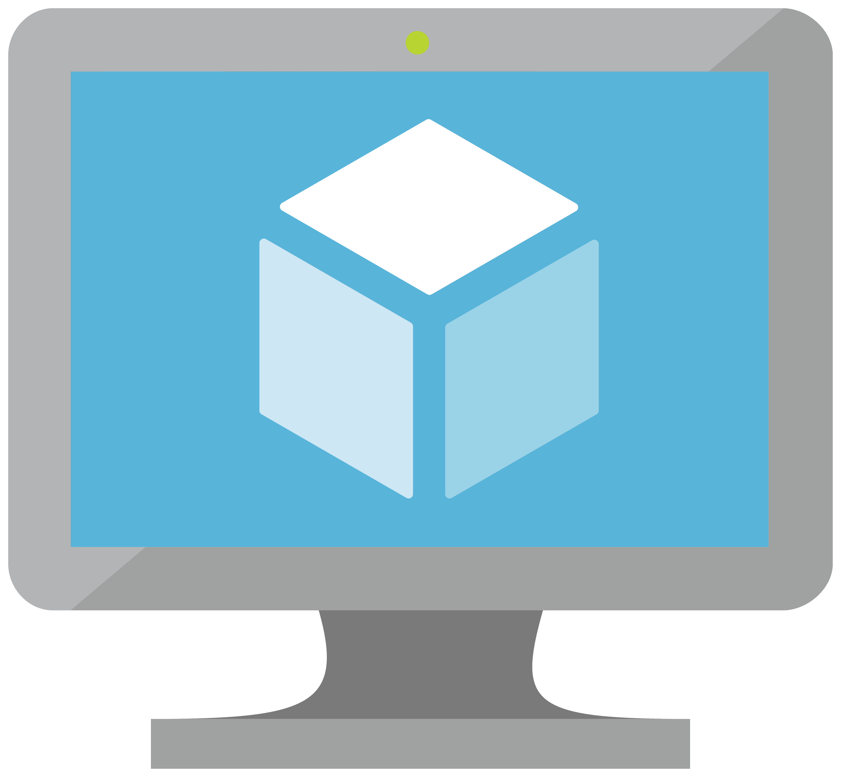
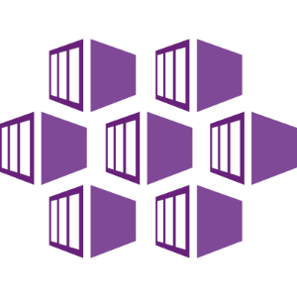
ISE Subnet
App Gateway Subnet
Integration Service Environment
Logic Apps
Multi-tenant Services
https://modern-apps.azurewebsites.net
https://prod-12.australiaeast.logic.azure.com:443
Public
Services
Azure Region #1
On Premise Data Centre
Notes:
So before we can look at these difference architectures I just wanted to do a level set
What I have on the diagram here is a normal azure function and a logic app.
By default, both of these are accessible from the internet as long as I’m correctly authorised.
For example… I can get the url for my azure function and put it in my browser.
This is a cause of concern for some organisations.
Once again… this can absolutely be secured, but either because of regulatory requirements, or else a desire to implement the same network isolation based security policies as they apply on-prem.. Many organistaions want their web applications, function apps and logic apps to be completely isolated from the internet.
---
VNET Faqs https://docs.microsoft.com/en-us/azure/virtual-network/virtual-networks-faq
VNET Calculator https://www.adminsub.net/ipv4-subnet-calculator/10.1.0.0/16

Slide 31
ISE Subnet
App Gateway Subnet
Integration Service Environment
Logic Apps
Multi-tenant Services
https://modern-apps.azurewebsites.net
52.237.205.163
https://prod-12.australiaeast.logic.azure.com:443
13.75.153.66
On Prem Network 10.1.0.0/16
Virtual Network 10.0.0.0/16
Create VNet
And Subnets
Azure Region #1
On Premise Data Centre
Notes:
IT Pros have been isolating workloads from the cloud for decades. It’s what they love to do !
The short version of how they do this is.
(Click) All websites have a numeric address called an ip address.
there are a few special ranges that don’t work from the internet. They are reserved for use inside work and home networks. These often start with 192.168. or 10.
(Click) For our demo we’ve chosed 10.1 to start all the addresses for our on-prem network
(Click) We can can also create a private network space inside our Azure cloud.
Let’s assign it all the addresses that start with 10.0.
Everything inside this network has a 10.0.somting private IP address that is not accessible at all to the internet, but that is able to be connected to the organisations on-prem private network.
This provides additional security to our internal resources. There is no way to access our private address space from the internet.

Slide 32
ISE Subnet
App Gateway Subnet
Integration Service Environment
Logic Apps
Multi-tenant Services
https://modern-apps.azurewebsites.net
52.237.205.163
https://prod-12.australiaeast.logic.azure.com:443
13.75.153.66
On Prem Network 10.1.0.0/16
Virtual Network 10.0.0.0/16
Function App
Gateway
Function App
(public preview)
23.123.67.3
Load Balancer
Firewall
Isolate APIs
App Gateway Subnet 10.0.1.0/24
API Management Subnet 10.0.2.0/24
App Service Environment Subnet 10.0.3.0/24
Azure Region #1
On Premise Data Centre
Notes:
Once we have that private network space – we can carve it up into smaller networks called subnets and reserve some blocks of ip addresses for different purposes. (Click) I have created two here - one to put web apps into, and one to our API Gateway into.
We can then wrap a firewall around each subnet – allowing us to control the traffic in and out of each subnet.
These tools are the security tools it pros have been using for decades. They are familiar and are what are going to bring a sense of comfort to the it pro and security teams.
(Click) Now that we have our private address spaces, and we have them locked down and controlled by firewalls, we can create our web compute and API gateway resources in those subnets.
Everything needed to run APIM and the compute for the functions is deployed into your private address space.
It’s worth noting that the api gateway isn’t an api – it’s an abstraction layer over the top of the actual apis that lets you manage security, performance and admin tasks related to your apis – e.g. a single pane of glass for things like auth, caching and rate limiting.
(Click) Now.. Because these isolated services only have an internal ip address… there is no way for them to be accessed, except from other private addresses like the ones on-prem.
If we did want controlled internet access to these resources, we would put in a load balancer and firewall that straddles the vnet and allows us to create specific rules about what traffic to allow into our private network and where it should go.
We have now essentially recrated the core of the Protected or PCI architectures.
---
VNET Faqs https://docs.microsoft.com/en-us/azure/virtual-network/virtual-networks-faq
VNET Calculator https://www.adminsub.net/ipv4-subnet-calculator/10.1.0.0/16

Slide 33

ISE Subnet
App Gateway Subnet
Integration Service Environment
Logic Apps
Multi-tenant Services
Data Services
Azure Storage
Cosmos Db
On Prem Network 10.1.0.0/16
Virtual Network 10.0.0.0/16
Function App
Private Endpoints
Gateway
Private Link Subnet 10.0.4.0/24
23.123.67.3
Function App
(public preview)
Load Balancer
Firewall
Private Link
App Gateway Subnet 10.0.1.0/24
API Management Subnet 10.0.2.0/24
App Service Environment Subnet 10.0.3.0/24
Azure Region #1
On Premise Data Centre
Notes:
What we are missing from our diagram however is our data stores.
(Click) Let’s put on the azure storage and cosmos from the original use case in.
Now… Because these services are based on massive shared infrastructure, there is no mechanism to actually deploy them inside our private virtual network.
(click) What we do instead is use the Private Link feature.
With private link we can block off all internet access to multi-tenant services, and create an entry point with a private IP address that becomes the only way to access that service.
The services are no longer accessible from the internet, but they are accessible from our other private resources in the vnet and from on-prem if we have the firewall rules configured to allow it.
(click) I know it’s networking.. And usually that’s not too exciting. But Private link is a really big deal.
It’s the feature that allows us to talk to security teams and explain that we can have network isolation Of public PaaS services.
It is absolutely key to enabling serverless in your Enterprise.
This is the solution that lots of our customers start with.
It gives the enough control and security to nearly any organisation, but is more complex to deploy, and costs more to run that our serverless compute.
------------------
https://azure.github.io/AppService/2020/03/16/Public-Preview-of-Private-Link-on-App-Service.html
Vmany customers have concerns about services that have public IP addresses that are accessible form the intetnet.. Even though those services have authentication requirements and can use other networking features like restricting ip addresses. They want the IP Address gone.
In our example for example – the architects or IT pros might require us to remove the IP Addresses from the Azure Storage account or Cosmos DB.
That’s exactly what Private Link does.
With privateLink – we create a network subnet.
Private Link enables you to host your apps on an address in your Azure Virtual Network (VNet) rather than on a shared public address. By moving the endpoint for your app into your VNet you can:
Private Link enables you to host your apps on an address in your Azure Virtual Network (VNet) rather than on a shared public address. By moving the endpoint for your app into your VNet you can:
Isolate your apps from the internet. Configuring a Private Endpoint with your app, you can securely host line-of-business applications and other intranet applications.
Prevent data exfiltration. Since the Private Endpoint only goes to one app, you don’t need to worry about data exfiltration situations.
(by christina)
Private Link exposes your app on an address in your VNet and removes it from public access. This not only secures the app but can also be combined with Network Security Groups to secure your network.

Slide 34
ISE Subnet
App Gateway Subnet
Integration Service Environment
Logic Apps
Multi-tenant Services
APIs
Data Services
Function App
Azure Storage
Function App
(public preview)
Cosmos Db
VNet Integration
Virtual Network
API Management (Premium)
Private Endpoints
Gateway
Functions Subnet
Private Link Subnet
23.123.67.3
VNet
Integration
Firewall
App Gateway Subnet
API Management Subnet
Azure Region #1
On Premise Data Centre
Notes:
** Vnet intro
The conversation we are having with many customers is how to move their web applications, functions and logic apps out of the private network, and instead run them as multi-tenant services, but still have great network control. This is going to be much cheaper, easier to manage and gives them all the benefits of the pure serverless solution.
The challenge is that now we have secured our data services using Private Link – the only way to access them is via the private network
This is where we use Vnet integration. Vnet integration let’s you create a subnet in your private address space, and then your applications get projected into that subnet.
From this functions subnet…. We can talk to the private endpoints for our data services.
With Private Link you can secure the inbound traffic, and VNet Integration you secures outbound traffic.
Can anyone see anything that someone who cared about network security might raise as a concern ?
That’s right… we have used Vnet integration to allow the functions to talk to the data services, but we haven’t locked them down yet. They are in the public address space.. And still accessible from the internet.
=================
In order for the function to access resources within the virtual network, VNet Integration is needed. The matrix of Azure Functions networking features shows that there are currently three options for VNet Integration:
Azure Functions Premium plan
Azure App Service Plan
Azure App Service Environment
As I like the purely serverless approach, I use an Azure Function Premium plan. By using an Azure Function Premium plan with VNet Integration enabled, the function is able to access Azure Storage and CosmosDB via the configured private endpoints.

Slide 35
ISE Subnet
App Gateway Subnet
Integration Service Environment
Logic Apps
Multi-tenant Services
APIs
Data Services
Function App
Azure Storage
Function App
(public preview)
Cosmos Db
Private Site Access
VNet Integration
Virtual Network
API Management (Premium)
Private Endpoints
Gateway
Functions Subnet
Private Link Subnet
Feature: private site access via service endpoints
Application Gateway
App Gateway Subnet
API Management Subnet
Azure Region #1
On Premise Data Centre
Notes:
Demo: https://www.michaelscollier.com/azure-functions-private-site-access/
Docs: https://docs.microsoft.com/en-us/azure/app-service/networking/private-endpoint
Using Private Endpoint for your Web App enables you to:
Secure your Web App by configuring the Private Endpoint, eliminating public exposure.
Securely connect to Web App from on-premises networks that connect to the VNet using a VPN or ExpressRoute private peering.
Avoid any data exfiltration from your VNet.
From a security perspective:
When you enable Private Endpoints to your Web App, you disable all public access.
You can enable multiple Private Endpoints in others VNets and Subnets, including VNets in other regions.
The IP address of the Private Endpoint NIC must be dynamic, but will remain the same until you delete the Private Endpoint.
The NIC of the Private Endpoint cannot have an NSG associated.
The Subnet that hosts the Private Endpoint can have an NSG associated, but you must disable the network policies enforcement for the Private Endpoint: see Disable network policies for private endpoints. As a result, you cannot filter by any NSG the access to your Private Endpoint.
When you enable Private Endpoint to your Web App, the access restrictions configuration of the Web App is not evaluated.
You can eliminate the data exfiltration risk from the VNet by removing all NSG rules where destination is tag Internet or Azure services. When you deploy a Private Endpoint for a Web App, you can only reach this specific Web App through the Private Endpoint. If you have another Web App, you must deploy another dedicated Private Endpoint for this other Web App.

Slide 36
ISE Subnet
App Gateway Subnet
Integration Service Environment
Logic Apps
Multi-tenant Services
APIs
Data Services
Function App
Azure Storage
Function App
(public preview)
Cosmos Db
VNet Integration
Virtual Network
API Management (Premium)
Private Endpoints
Private Endpoints
Gateway
Private Link Subnet
Functions Subnet
Private Link Subnet
23.123.67.3
Private Functions with Private Link
Firewall
App Gateway Subnet
API Management Subnet
Azure Region #1
On Premise Data Centre
Notes:
What have done here is isolated the azure functions using Private Endpoints.
our API Gateway is in the private address space, it can talk to the private endpoints for the functions, the functions then use vnet integration to talk to the private endpoints for the data services.
(click) we have The best of both worlds !
We are using multi-tenant serverless compute and storage – getting all the cost and scalaing benefits. …. And ensuring network isolation as well.
----------------
Demo: https://www.michaelscollier.com/azure-functions-private-site-access/
Docs: https://docs.microsoft.com/en-us/azure/app-service/networking/private-endpoint
Using Private Endpoint for your Web App enables you to:
Secure your Web App by configuring the Private Endpoint, eliminating public exposure.
Securely connect to Web App from on-premises networks that connect to the VNet using a VPN or ExpressRoute private peering.
Avoid any data exfiltration from your VNet.
From a security perspective:
When you enable Private Endpoints to your Web App, you disable all public access.
You can enable multiple Private Endpoints in others VNets and Subnets, including VNets in other regions.
The IP address of the Private Endpoint NIC must be dynamic, but will remain the same until you delete the Private Endpoint.
The NIC of the Private Endpoint cannot have an NSG associated.
The Subnet that hosts the Private Endpoint can have an NSG associated, but you must disable the network policies enforcement for the Private Endpoint: see Disable network policies for private endpoints. As a result, you cannot filter by any NSG the access to your Private Endpoint.
When you enable Private Endpoint to your Web App, the access restrictions configuration of the Web App is not evaluated.
You can eliminate the data exfiltration risk from the VNet by removing all NSG rules where destination is tag Internet or Azure services. When you deploy a Private Endpoint for a Web App, you can only reach this specific Web App through the Private Endpoint. If you have another Web App, you must deploy another dedicated Private Endpoint for this other Web App.

Slide 37
ISE Subnet
App Gateway Subnet
Integration Service Environment
Logic Apps
Demo
Multi-tenant Services
APIs
Data Services
Function App
Azure Storage
Function App
(public preview)
VNet Integration
Virtual Network
Private Endpoints
Functions Subnet
Private Link Subnet
Demo
Private Endpoints and
VNet Integration
Azure Region #1
On Premise Data Centre
Notes:
Demo: https://www.michaelscollier.com/azure-functions-private-site-access/
Docs: https://docs.microsoft.com/en-us/azure/app-service/networking/private-endpoint
Using Private Endpoint for your Web App enables you to:
Secure your Web App by configuring the Private Endpoint, eliminating public exposure.
Securely connect to Web App from on-premises networks that connect to the VNet using a VPN or ExpressRoute private peering.
Avoid any data exfiltration from your VNet.
From a security perspective:
When you enable Private Endpoints to your Web App, you disable all public access.
You can enable multiple Private Endpoints in others VNets and Subnets, including VNets in other regions.
The IP address of the Private Endpoint NIC must be dynamic, but will remain the same until you delete the Private Endpoint.
The NIC of the Private Endpoint cannot have an NSG associated.
The Subnet that hosts the Private Endpoint can have an NSG associated, but you must disable the network policies enforcement for the Private Endpoint: see Disable network policies for private endpoints. As a result, you cannot filter by any NSG the access to your Private Endpoint.
When you enable Private Endpoint to your Web App, the access restrictions configuration of the Web App is not evaluated.
You can eliminate the data exfiltration risk from the VNet by removing all NSG rules where destination is tag Internet or Azure services. When you deploy a Private Endpoint for a Web App, you can only reach this specific Web App through the Private Endpoint. If you have another Web App, you must deploy another dedicated Private Endpoint for this other Web App.

Slide 38
#2 Technical Challenge: Multi-Cloud / Avoid Vendor Lock-in
Notes:
The other key challenge we hear from enterprises against running serverless is that it locks them into to a single cloud platform.
Customers that are looking to stay cloud agnostic and avoid vendor lock in are focusing on building platforms based on containers.

Slide 39
Azure Container Instances (ACI)
$ az container create --name adams-ndc001 --image microsoft/aci-helloworld --resource-group adams-aci-demo-rg --ip-address public
"ipAddress": {
"ip": "52.168.86.133",
"ports": [...]
},
"location": "eastus",
"name": "mycontainer",
"osType": "Linux",
"provisioningState": "Succeeded",
$ curl 52.168.86.133
<html>
<head>
<title>Welcome to Azure Container Instances!</title>
</head>
Notes:
Azure Container Instances are a pure serverless mechanism for running containers.
It’s amazing how easy they are.
To create a serverless container you use the “az container create” command, give the container a name, tell it what image to use and which resource group to put it in and whoether or not to give it a public ip address. That’s literally it. For this demo the container is a simple web app and we said for it to have a public IP Address.
We can hit that IP address, The container will be provisioned, it will execute, and then if the endpoint isn’t hit again, it will be de-allocated and we only get billed for the seconds that the conpute is actually executing.
Of course…. That container that we executed could have been any container including an azure function, or a function running a logic app on it.
While this is very cool…. The reality is that most container workloads are going to need to interact with other containers, and a container orchestration platform is going to be required to manage the containers
=========== demo script ===========
Actual Demo: for ($num = 1 ; $num -le 100 ; $num++){curl 20.53.126.204}

Slide 40
Functions on AKS
VM
VM
Pod
Pod
Pod
Pod
Pod
Pod
Pod
Pod
Application architect
Kubernetes control pane
Deployment/ tasks
Infrastructure architect
Pod
Pod
Pod
Pod
Pod
Pod
Pod
Pod
VM
VM
Notes:
Of course Kubernetes is the defacto standard now for container orchestration and all the cloud providers have a PaaS K8s platform.
Just like how we can run Azure functions on ACI… we can also run Functions in our Kubernetes clusters.
This means we can use our serverless programming model, in our container orchestrator.

Slide 41
AKS Virtual Node Bursting with the ACI Connector
VM
VM
Pod
Pod
Pod
Pod
Pod
Pod
Pod
Pod
Azure Container Instances (ACI)
Pod
Pod
Pod
Pod
Pod
Application architect
Kubernetes control pane
ACI Connector
Pod
Pod
Pod
Pod
Pod
Pod
Pod
Pod
Pod
Pod
Pod
Pod
Pod
Pod
Pod
Deployment/ tasks
Pod
Pod
Pod
Pod
Pod
Infrastructure architect
Pod
Pod
Pod
Pod
Pod
Pod
Pod
Pod
VM
VM
Notes:
Where things get really interesting though is when you put Kubernetes together with Azure Container Instances.
Each of the nodes in this cluster are VMs under the covers.
What’s really cool is that we can create an Kubernetes node that is just comprised of Azure Container Instances.
This means that this node has no resting cost….but when put under load will scale almost infinitely.
We then connect it to our cluster using the ACI Connector which is powered our open source Virtual Kubelet technology

Slide 42
AKS Virtual Node Bursting with the ACI Connector
VM
VM
Pod
Pod
Pod
Pod
Pod
Pod
Pod
Pod
Azure Container Instances (ACI)
Pod
Pod
Pod
Pod
Pod
Application architect
Kubernetes control pane
ACI Connector
Pod
Pod
Pod
Pod
Pod
Pod
Pod
Pod
Pod
Pod
Pod
Pod
Pod
Pod
Pod
Deployment/ tasks
Pod
Pod
Pod
Pod
Pod
Infrastructure architect
Pod
Pod
Pod
Pod
Pod
Pod
Pod
Pod
VM
VM
Notes:
This means we can run Azure functions not just on our standard Kubernetes nodes….
but run the serverless programming model of azure functions, on the serverless container compute engine of Azure Container Instances.

Slide 43
ISE Subnet
App Gateway Subnet
Integration Service Environment
Logic Apps
Multi-tenant Services
Data Services
Container Instances
Azure Storage
Azure Front Door Service
Cosmos Db
Virtual Network
API Management (Premium)
Private Link
Gateway
Container Instances VNET
Private Link Subnet
Feature: Functions on Isolated AKS
Firewall
App Gateway Subnet
API Management Subnet
AKS Subnet
Azure Region #1
On Premise Data Centre
Notes:
Bringing that into our architecture diagram….
This means we get the benefits of running functions in our Kubernetes cluster on a private network, and also leveraging the virtual node technology using Azure Container instances that can also run in the VNET.
This has massive potential for customers. The can leverage the serverless programming models of functions and logic apps…. Deploy them into a private network environment, and still enjoy the benefits of 0 resting cost, infinitely scaling serverless compute.
It sounds too good to be true… and it kind of is.
The issue with Kubernetes is that customers always under-estimate it’s complexity, and the need to have a team of experts to manage the Kubernetes platform.
Don’t let your organization work out how to do Kubernetes. If you want to be successful you need to get someone in who has done it before.
I’ll talk more about this when we get to customer examples, which is a great Segway into our next section…..
---------------------------------------
Container instances in a VNET: https://docs.microsoft.com/en-us/azure/container-instances/container-instances-vnet
ACI VNet integration works similar to App Service Regional VNet integration.
ACI runs on managed Service Fabric clusters, when you choose to attach ACI to a VNet, an additional NIC is added to the underlying VM that is connected to your VNet
This NIC is isolated and attached directly to your container (if you know how Linux network namespaces work, this explains why there isn’t ACI VNet attach on Windows Containers 😝)
For a bit of a deeper dig into ACI:
https://www.youtube.com/watch?v=giQLmxMKAKE
Note: this is a cheaper option than running an ISE if you want to do logic apps in a private address space

Slide 44
Tips for serverless adoption
Drive the business value from the top down
Drive agility and innovation from the bottom up
Get the CSO / Infra team involved early
Empower the IT Pros
Pivot the conversation to the controls they require
Promote a patterns based approach

Slide 45
How you should build your next app
Agenda
Why isn’t everyone doing this today?
What are people doing now?
Notes:
Duncan:
Now we have looked at the perfect pure serverless reference architecture for building an API on Azure and discussed the network isolation challenges that stop customers from doing serverless in this way. We wanted to run though a bunch of case studies from real customers we have worked with building serverless on Azure.

Slide 46
Serverless API case study
Static HTML + JS Website
Notes:
Duncan:
To start with we are going to look at a case study of a team who is doing a greenfield set of APIs using Azure functions.
This case study also is the beginning of a trend Adam and I and our fellow Azure App Dev specialists in Australia are starting to see more of. And that is large enterprise companies going all in writing their APIs not in a traditional way but using purely serverless functions. Adam and I work with about 20-30 enterprise customers each and we would say almost all our customers are using Azure functions and logic apps in one way or another, in particular for integration, but we are seeing more and more customer building complete API’s with just functions.

Slide 47
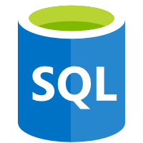
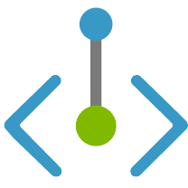

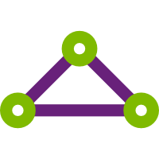
Serverless API case study
Multi-tenant Services
APIs
Data Services
Function App
SQL Database
Function App
Blob
Storage
VNet Integration
Hub VNet
Spoke VNet
VNet
Peering
Private Endpoints
Private Endpoints
Private Link Subnet
Functions Subnet
Private Link Subnet
Application Gateway
Express route
Azure Region #1
On Premise Data Centre
Static Assets
Static HTML + JS Website
Notes:
ADAM – GET READY TO TAKE CONTROL
Duncan:
This case study will look very much like the network isolation examples we just covered. They used only Function Apps for their APIs backed by Azure SQL but still needed access to some of their services on premise.
(click) This company followed a hub and spoke architecture in setting up their virtual networks to achieve a higher separation of concerns between deploying and managing central IT team resources and workload team resources. Also to be able to have a clearer control gates and monitoring between entry in and out of different environments.
(click) In the Hub VNet they had an application gateway and a series of firewalls and was far from as simple as I have depicted in this box.
(click) In the Spoke VNet they had a very similar set up to the ones we looked at just before using a combination of VNet integration with premium functions and private endpoints to communicate between their Azure services.
(click) to communicate between the hub and spoke they used VNet peering (click) and to talk back On Premise they used express route.
The premium functions are a key part here as they allow for setting a minimum of pre-warmed instances to run your app with no cold starts, as cold starts have been a blocker for some people to write their mission critical API’s in functions. Premium functions are also key for being able to use VNet integration and private endpoints .
The other interesting point here is a lot of these parts are relatively new with premium functions being only a year and bit old and private endpoints being only several months old. I think this combination of easier cost effective network isolation, no cold starts and serverless in the enterprise becoming more main stream in general, is going to lead to us seeing a lot more companies in the enterprise default to serverless for their APIs.
References:
Hub and spoke architecture - https://docs.microsoft.com/en-us/azure/cloud-adoption-framework/ready/azure-best-practices/hub-spoke-network-topology

Slide 48
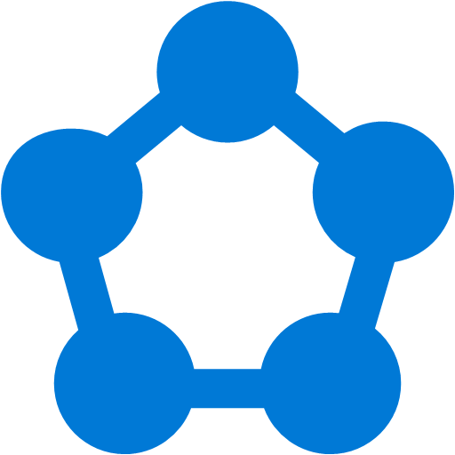
Enterprise Integration
Problem Scenario #1: Integration Sprawl
APIs
Integration points
Consumers
Notes:
The number 1 serverless scenario that I’m working on with customers is integration.
The complaint I hear over and over is that enterprises have been doing point to point integrations for years
and now have integration environments that are incredibly complex, hard to maintain and fragile.

Slide 49
Enterprise Integration
Problem Scenario #2: Big Black Box Integration
ESB
Consumers
Notes:
The other use case where I get asked for help al ot is with customers who are modernising big, black box integrations platforms.
in the past the Entperprise Service bus was the gold standard of integration… If you were an enterprise you had to have an ESB.
The are big black boxes that are really powerful. you can put all your apis in, all your workflow logic in and can manage all your external connections…
But the challenge with them are the same challenges we always face with monoliths.
I’m working with half a dozen customerms at any point in time about moving away from these monoliths and into a modern integration platform that has multiple parts that each do one thing very well, they are able to be developed, deployed, upgraded and scaled independently, and cost orders of magnitude less both in licensing and development and operating costs.

Slide 50
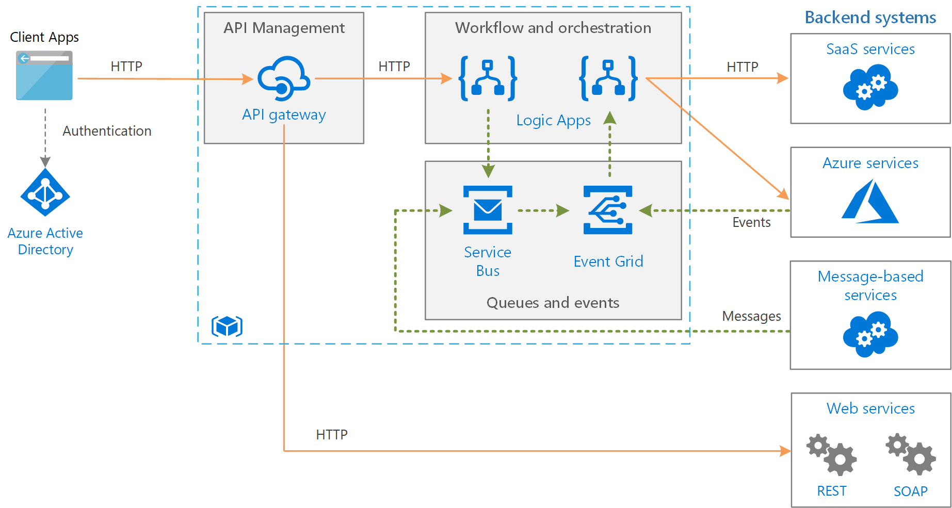
ISE Subnet
App Gateway Subnet
Integration Service Environment
Logic Apps
Enterprise Integration
API Management Subnet
https://docs.microsoft.com/en-us/azure/architecture/reference-architectures/enterprise-integration/queues-events
Notes:
This reference architecture integrates enterprise backend systems, using message queues and events to decouple services for greater scalability and reliability.
It has Logic Apps to orchestrate workflows and implement no-code integrations
API Management is being used for publishing catalogs of HTTP APIs, to promote reuse and discoverability.
And it using message queues and events to decouple services for greater scalability and reliability.
Small, targeted independency serverless components all working together to form a complete platform.
-----------------------
** Resources **
Basic architecture: https://docs.microsoft.com/en-us/azure/architecture/reference-architectures/enterprise-integration/basic-enterprise-integration
With events and messages: https://docs.microsoft.com/en-us/azure/architecture/reference-architectures/enterprise-integration/queues-events

Slide 51

ISE Subnet
App Gateway Subnet
Integration Service Environment
Logic Apps
ESB Black Box to Serverless Logic Apps and Functions
Multi-tenant Services
Service Bus
Azure Storage
Event Grid
Data Factory
Cosmos Db
Virtual Network
SQL Managed Instance
Private Endpoints
SQL MI Subnet
Private Link Subnet
API Management (Premium)
Private App Service
Web APIs
Gateway
Functions
Application Gateway
Logic Apps
Isolated PaaS Application
App Gateway Subnet
API Management Subnet
App Service Environment Subnet
Azure Region #1
On Premise Data Centre
Notes:
The #1 use case for Logic Apps is enterprise integration. They are the cornerstone of integration.
The customers I have been working with have obviously been either running multi-tenant logic apps or paying for Integration Service Environments to run their logic apps on isolated compute.
I’m actually working with now several customers that are aiming to go to prod early in the new year once Logic Apps on functions goes GA.
One in particular is quite typical of these ESB modernisations.
They are modernisation a decades worth of biztalk services.
They have multiple servers running biztalk, and migrating away from biztalk one biztalk service at a time.
This isn’t uncommon. I’m working with customers moving from at least 3 different monolithic ESBs at the moment, and unfortunately there is no magic sauce.
It’s a case of taking a thin slice of the services in the ESB – biztalk in this case… creating the replacement services in APIM, Logic Apps, Functions, Service Bus and Event Grid and then removing those services from the legacy ESB.

Slide 52

ISE Subnet
Serverless integration case study
Multi-tenant Services
Compute
Function App
Service Bus
VNet Integration
VNet
Private Endpoints
Private Link Subnet
Functions Subnet
Traffic Manager
Application Gateway
API Management
ISE -
Integrated Service Environment
Express route
Azure Region #1
On Premise Data Centre
Notes:
Duncan:
On the topic of serverless and integration I have another customer case study I would like to share as it highlights the shift away from expensive isolated services towards serverless VNet integrating multi-tenant services.
This architecture is heavily based on using logic apps to process requests do a bunch transformation of the payload and pass on to different on-premise services.
(click) They use Azure traffic manager to load balance between azure regions and app gateway with a firewall to manage access to internal and external APIs with API management.
(click) It is heavily based on logic apps to coordinate this workflow and uses an integrated service environment or ISE to achieve network isolation. An ISE is an instance of the Logic Apps service that uses dedicated resources and runs separately from the multi-tenant Logic Apps service.
(click) In conjunction with logic apps they are using a service bus and functions which is very common to see for integration workflows like this and achieving network isolation with private endpoints and VNet integration. Service bus does not have a serverless tier, but this customer is not focused on serverless and has no serverless advocate beating the drum crusading to change everything to serverless they are just using the best tools for the job which happens to be a mix of serverless.
(click) They are also using express route to talk to on-premise services.

Slide 53
ISE Subnet
Serverless integration case study
Multi-tenant Services
Compute
Function App
Service Bus
VNet Integration
VNet
Private Endpoints
Private Link Subnet
Functions Subnet
Traffic Manager
Application Gateway
API Management
ISE -
Integrated Service Environment
Express route
Azure Region #1
On Premise Data Centre
Notes:
Duncan:
So the flow goes like this a request goes via API management
(click) that triggers a logic app to put a message on the service bus.
(click) Another logic app is polling the service bus for those messages.
(click) When that logic app gets a message from the service bus it transforms the payload
(click) In conjunction with some work being done in a function
(click) And then passes the transformed payloads onto on-premise services.

Slide 54
ISE Subnet
Serverless integration case study
Multi-tenant Services
Compute
Function App
Service Bus
Function App
VNet Integration
VNet
Private Endpoints
Private Link Subnet
Functions Subnet
Traffic Manager
Application Gateway
API Management
ISE -
Integrated Service Environment
Express route
Azure Region #1
On Premise Data Centre
Notes:
** ADAM GET READY ***
Duncan:
So this is a cool demonstration of enterprise integration using serverless logic apps and functions. But as I mentioned this ISE is an instance of the Logic Apps service that uses dedicated resources and runs separately from the multi-tenant Logic Apps service. This sounds great but they are thousands of dollars a month worth of compute power and if, as in the case for this customer, you do not need all that compute it will be under utilised and be the opposite of serverless in the sense of not being able scale to zero.
At the moment an ISE is the only way to get network isolation with logic apps as there is no private endpoints or vnet integration for the consumption based tier, but this is changing with the new public preview of logic apps on the functions run time. And when they are out of public preview this company will (click) move off the ISE and use a premium functions app to host their logic apps as a multi-tenant service.
This will not only save them money from using a cheaper service. But there is another challenge when using dedicated resources like an ISE and that is that it takes hours to deploy them and in the case of a region outage to avoid waiting those hours to recover, you need another region left active adding more cost and overhead.
I think this is an example of not only more and more companies using a combination of multi tenant services with network isolation. But also one of more and more companies using the serverless tiers to be able to spin up and tear down services more easily not just for disaster recovery but also for dev/test scenarios and blue green deployments.
I hope as more companies and their security and network teams get more practice using and securing multi-tenant cloud services that they do not just default to network isolation based security and start to use more modern identity based security patterns. Implementing all this network isolation takes up a lot of dev time and energy and although it is often necessary, I think not managing the underlying networking like not managing the underlying servers in serverless can help save time and money and I often joke and ask if peoples serverless architecture is also networkless for this reason.

Slide 55
ISE Subnet
App Gateway Subnet
Integration Service Environment
Logic Apps
Serverless on Kubernetes case studies
Notes:
*** ADAM PRESENTS ****
I have very mixed feeling about Kubernetes.
My Kubernetes customers are my best stories and my worst stories.
I worked with a customer who said ‘I want to do containers, therefore I must do Kubernetes, therefore I must do microservices, and I need a service mesh, and I need to only use open source everything, and I need and I need and I need’. I felt like the handbrake… contstantly telling them slow down and simplify but it didn’t work.
The developers all ended up with great resumes. But of course the project wasn’t a success.
On the other end of the spectrum I had an education customer who needed to build a system to support thousands of concurrent requests.
They had a strong development team, and were already running several core systems on PaaS,
They wanted to improve their developer onboarding time, their devops processes and move towards a microservices architecture.
The approach they took was to start building on AKS, but they built the first applications using the same core technologies and patterns that they were familiar with.
.. But just did it on Kubernetes.
They were massively successful. They were in production 16 weeks after the project kicked off.
.. Then they started to focus on moving towards Microserverices and incrementially adding cloud native tooling and architectures.
- Including running functions on Kubernetes

Slide 56
ISE Subnet
App Gateway Subnet
Integration Service Environment
Logic Apps
Serverless Kubernetes case study
Multi-tenant Services
Service Bus
Azure Storage
Cosmos Db
Virtual Network
SQL Managed Instance
Private Endpoints
SQL MI Subnet
Private Link Subnet
API Management
Kubernetes
Gateway
Application Gateway
App Gateway Subnet
API Management Subnet
Azure Region #1
On Premise Data Centre
Notes:
My other interesting Kubernetes story is about a large engineering customer
The CIO that mandated an approach that avoided vendor lock in… buthte architects and developers wanted to get the benefits of serverless.
So we worked with them around each technology choice.
AKS for Kubernetes was an easy choice for them.
They also chose to leverage Azure functinos as their preferred platform as it fits perfectly with what they are trying to achieve. They get the benefits of serverless… but running it on their cloud agnostic Kubernetes cluster.
They are using CosmosDB and SQL Server as their databases as SQL Can be run anywhere and if they do need to move away from Cosmos they can switch it out with MongoDB.
Now that Logic Apps run on functions, they also intend to start leveraging Logic Apps.
They have been very very successful and are up to building their 5th app on this platform – as well as many integration scenarios.
The key to their success was similar to the education organisations. They implemented their changes incrementally – and brought in experts who had done It many times before to show them the right way to do things, rather than trying to re-invent the wheel and work it out themselves.
That’s my #1 big tip for Kubernetes. Don’t try and figure it out yourself, or do it in a big bang.
Where with functions and paas a developer can work it out,
The learning curve on Kubernetes is steep … and on top of the development Kubernetes really requires a core team to to operate the platform… while the developers focus on building the workloads.

Slide 57
What is coming next

Slide 58
ISE Subnet
App Gateway Subnet
Integration Service Environment
Logic Apps
Multi-tenant Services
Multi-tenant Services
Enterprise Integration
Service Bus
Azure Storage
Logic Apps running functions runtime
Data Factory
Cosmos Db
Virtual Network
SQL Managed Instance
Private Endpoints
SQL MI Subnet
Private Link Subnet
API Management (Premium)
Private App Service
Logic Apps
Web APIs
Functions
ISE Private Link Subnet
Gateway
Application Gateway
Logic Apps
Isolated PaaS Application
App Gateway Subnet
API Management Subnet
App Service Environment Subnet
Azure Region #1
On Premise Data Centre
Notes:
Duncan:
As we have mentioned several times. Logic apps is coming on the functions run time
It’s going to be a big deal
It opens up running logic apps everywhere.
No more expensive ISEs

Slide 59
More Serverless Tiers
SQL Server
API Management
Logic Apps
Azure Functions
Event Grid
CosmosDB
Notes:
https://azure.microsoft.com/en-au/overview/serverless-computing/

Slide 60
ISE Subnet
App Gateway Subnet
Integration Service Environment
Logic Apps
Multi-tenant Services
Serverless Everywhere (and any on-prem K8s)
Azure Storage
Kubernetes
Cosmos Db
Virtual Network
K8s on VMWare
Private Endpoints
Private Link Subnet
On-Prem API Gateway
API Management
Kubernetes
Gateway
Application Gateway
Isolated PaaS Application
App Gateway Subnet
API Management Subnet
Azure Region #1
On Premise Data Centre
Notes:
Adam:
I almost put this in as a case study… I’ve got a couple of customers looking at this but they aren’t ready to do it yet.
Everyone is getting in into Kubernetes.
(click) Lots of vendors are enabling Kubernetes to run on their on prem hardware
What this means for customers is that their on-prem hardware investments just got the ability to deploy serverless.
We believe we are going to see this more and more.
The other part to this story is management of those on-prem clusters can now be done from the azure portal, even ones that are in VMWare.
(Click) Azure Arc lets you attach and configure Kuthbernetes clusters inside or outside of Azure. It let’s you manage, deploy and monitor all your Kubernetes clusters from the Azure portal no matter where they are deployed
Arc for Kubernetes is still in preview… but we already have customers very keen to get it depoyed.
------------
I almost put this in as a cast study… but they aren’t actually doing it yet.
Some customers would love to be leveraging Serverless, but are stuck with big investments of on prem hardware, which makes it hard to make the business case for cloud.
I have a couple I am working with that are very excited about being able to do Serverless leveraging their on-prem VMWare clusters.
(Click) What’s enabling this is that Vmware Vsphere 7 includes the capability to run Kubernetes natively inside Vmware.
By itself that’s pretty cool.. Customers can leverage the serverless programming model of functions and logic apps on prem in the VMWare Clusters.
What makes it even more exciting is our announcement of Azure Arc.
(Click)Arc lets you attach and configure Kubernetes clusters inside or outside of Azure. It let’s you manage all your Kubernetes clusters from the Azure portal no matter where they are deployed even On prem or in other clouds.
This let’s them be managed, deployed and monitored the same way regardless of where they are.
Arc for Kubernetes is still in preview… but we already have customers very keen to get it depoyed.
https://blogs.vmware.com/vsphere/2020/04/how-to-get-vsphere-with-kubernetes.html

Slide 61
Free swag
Join Community Newsletter: https://aka.ms/DevNewsletterJoin
Claim your Azure swag*: https://aka.ms/AzureDeveloperSwag
Secret swag codes:
DUNC20
ADAM20
* First 4 entrants per speaker per session. T&Cs apply.

Slide 62
Serverless isn’t cutting edge.
Functions go everywhere
Summary
Serverless conversations start with security
Serverless is about agility
Notes:
Adam:
If you walk out today with a just a few messages I hope they are
Serverless isn’t cutting edge anymore.. It’s an everyday tool used by enterprise.
Functions go everywhere
If you can, run them on our serverless compute.
If you can’t, stick them on-prem, into Kubernetes or onto another cloud provider…
Functions let you do serverless programming today, regardless of where you need to deploy.
Serverless Conversation start with security.
If you want to do serverless in the Enterprise you have to do it as a team – and you can’t do it without security and infrastructure being on board..
The awesomething about serverless is that it brings agility..
It help you ship your code to production every day.
We hope you’ve enjoyed our talk and that you’re leaving with some tips on how to be successful with serverless in your enterprise.

Slide 63
Thank you
Notes:
We will hang around and take questions..
Feel free to reach out on the conference Slack to say Hi.
Thanks you very much !

Slide 64
Multi-tenant Services
Data Services
Total = $14765
DR = $29530
$4
Azure Storage
$553
Cosmos Db
On Prem Network 10.1.0.0/16
Virtual Network 10.0.0.0/16
$22
$537
$3873
$7517
$2292
Private Endpoints
Private Link Subnet 10.0.4.0/24
App Gateway
Gateway
Integrated Service Environment
App Service Environment
App Gateway Subnet
API Management Subnet
Integrated Service Environment Subnet
App Service
Environment Subnet
Azure Region #1
On Premise Data Centre

Slide 65
Multi-tenant Services
Data Services
Total = $7382.5
DR = $14765
$4
Azure Storage
$553
Cosmos Db
On Prem Network 10.1.0.0/16
Virtual Network 10.0.0.0/16
$22
$537
$3873
$2292
Private Endpoints
Private Link Subnet 10.0.4.0/24
App Gateway
Gateway
App Service Environment
App Gateway Subnet
API Management Subnet
App Service
Environment Subnet
Azure Region #1
On Premise Data Centre

Slide 66
Multi-tenant Services
APIs
Data Services
Total = $4630
DR = $9260
$228
Function App
$4
Azure Storage
$1
Cosmos Db
On Prem Network 10.1.0.0/16
Virtual Network 10.0.0.0/16
$22
$537
$3873
Private Endpoints
Private Link Subnet 10.0.4.0/24
App Gateway
Gateway
App Gateway Subnet
API Management Subnet
Azure Region #1
On Premise Data Centre
Notes:
I’m already loving this !

Slide 67
Multi-tenant Services
API Management
APIs
Data Services
Total = $252.3
DR = $504.3
$0
$228
Function App
$4
Azure Storage
Gateway
$0.3
Cosmos Db
On Prem Network 10.1.0.0/16
Virtual Network 10.0.0.0/16
$22
Private Endpoints
Private Link Subnet 10.0.4.0/24
Azure Region #1
On Premise Data Centre
Notes:
I’m already loving this !

Slide 68
Integration Service Environment
Logic Apps
Multi-tenant Services
API Management
APIs
Data Services
Total = $4.3
DR = $8.6
$0
$0
Function App
$4
Azure Storage
Gateway
$0.3
Cosmos Db
On Prem Network 10.1.0.0/16
Virtual Network 10.0.0.0/16
Azure Region #1
On Premise Data Centre
Notes:
I’m already loving this !

